Slide 1

Ryan Guenette || RBC Branch Manger
Pain point:
“I have a lineup of clients that I am unable to serve!
I am wasting valuable time talking to tech support about my branch’s servers going down”
VALUE STATEMENT:
Optimize Ryan’s business process by allowing him to directly patch his servers with a slack command
PROBLEM

Slide 2
Business Process Flow Diagram
PROBLEM

Slide 3
Business Process Flow Diagram
Ryan patches his server with a slack command
PROBLEM

Slide 4
Ansi-bot
Team 10: George Xu, Kristina NIEVERA, Zack Norman, Kaitlin English, Fraser Stevenson
Notes:
Ansible is an automation tool used to run jobs on a server, or many servers at once.
RBC uses ansible to perform maintenance and troubleshooting with all servers.

Slide 5

The problem…
Current RBC server live troubleshooting can take more than a minute and a half (90 seconds)
Imagine 20 issues per day:
20x90s = 1,800 seconds each day,
130.5 hours lost yearly to wait-times.
Notes:
261 work days in a year, 20 x 261 x 90 = 469800 seconds = 130.5 hours

Slide 6
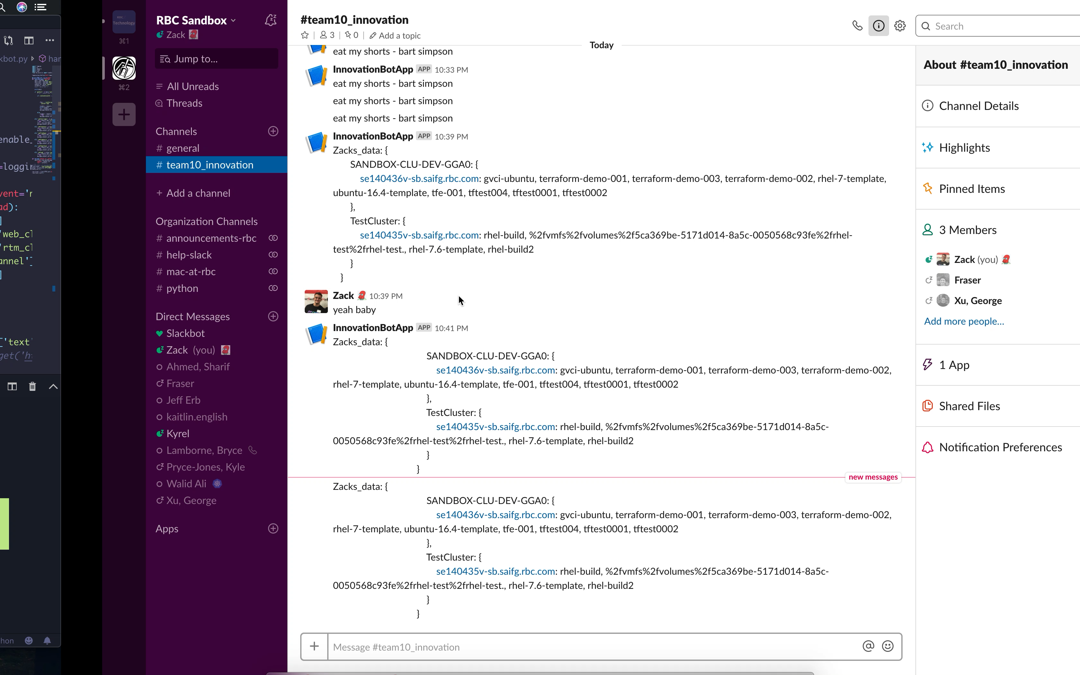
Solution?
**Short video** (It only takes 6 seconds, take out the middle man, hook ansible up directly to slack)

Slide 7
Improvements!
*Note: This does not include savings in branch managements, call centers, and admin support. Estimated savings would be well over $5m+
Increased Accessibility!
Upwards of $100k Savings yearly!*
95% More Efficient!
Notes:
3. With a time difference of 6 seconds vs. 90 seconds its 95% more efficient, this means we’re saving 121.8 hours yearly.
2. The salary of a software engineer at RBC is around $126,551 or $60/hour (2,088 hrs worked in a year). This means that we’re saving $7,308 yearly per engineer. If there’s at least 14 engineers who help maintain all RBC servers, that’s 100k savings yearly. Should the wait time be longer than 90 seconds, it’s extremely scalable as should it take 10 minutes, our code we’ll be savings 50k per employee vs. 7k.
1. We’re promoting self help by allowing users to jump right into a slack channel with engineers that are using this api.

Slide 8
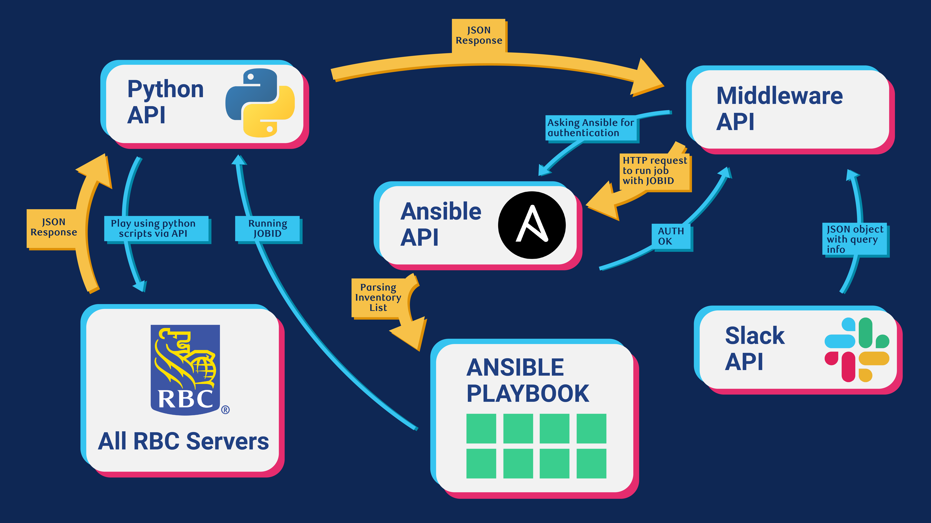
Tech Layout

Slide 9
Next steps
Complete Provision/destruction of VA’s
End-to-end Automation
Reboot, shut down, patching and update
Anything!
Notes:
Supporting complete provisioning and destruction of virtual assets
Complete end-to-end automation via slack
Reboot, shut down, patching and update functionality
Anything we can code, we can autonomously run on RBC servers from slack

Slide 10
Thank you!
Questions?

Slide 11
SAVINGS MODEL
Metrics: | Value:
Average salary of software-engineer at RBC | $126,551
Hours worked in a year | 261 x 8 = 2,088 hrs
Daily salary of software-engineer at RBC | $126,551 / 2,088 hrs = $60.6 per hr
Time wasted between Ansible and Ansi-bot | 130.5 hrs/yr – 8.7 hrs/yr= 121.8 hrs/yr
Money saved with Ansi-bot per engineer | $60.6 per hr x 121.8 hrs/yr = $7,308 per yr
Money saved with Ansi-bot for team size est (14) | $7,308 per yr x 14 = $102,312 per year
Notes:
Say it’s 10 minutes, (600 seconds x 20 x 251 ) / 1200. = 840 hours, equals to 50k per employee

Slide 12
BIBLIOGRAPHY
1. Work days in a year: https://hr.uiowa.edu/payroll/2015-fiscal-year-payroll-calendar
2. Dave Mckay: http://www.bnnbloomberg.ca/government-support-for-energy-sector-growth-urgently-needed-rbc-s-mckay-1.1159063
3. RBC Software Engineer Salary: https://www.glassdoor.com/Salary/RBC-Software-Developer-Salaries-E3358_D_KO4,22.htm
4. Arbie: https://deskgram.net/explore/tags/ArbieGoesRogue

